Slide 1
SMM Sustainability Report
Q3 2023-24
southmelbournemarket.com.au

Slide 2
Contents
1. Sustainability performance Q3
Performance at a Glance
Waste
Electricity
Water
2. Sustainability Strategy Q3 actions & achievements
Strategy Actions update
Food rescue
Embedding sustainability
Early adopter Sustainability Grant: Theo’s Deli

Slide 3
01
Sustainability Performance
YTD 2023 – 2024

Slide 4
Sustainability performance Q3 23-24
Performance at a glance
Average Usage/Generation per Customer*
KPI SMM Environmental Sustainability Strategy 2025-27
 | Waste diversion | Potable water (KL) | Electricity (kWh)
Baseline YTD 2018-19* | 65.9% | 20,955.53 | 667, 044
Actual YTD 2023-24 | 66.5% +0.6% | 18,497.48 -11.7% | 610,144 –2.8% **
2027 target | 85% | 10% reduction | 25% reduction
Status
2018-19 YTD | 2023-24 YTD
0.47 kg | 0.34 kg
0.15 kWh | 0.14 kWh
5 L | 4.28 L
On
track
On
track
On
track
 | 18-19 | 23-24 | Diff.
 | 4,183,712 | 4,121,578 | - 1.5%
* 2018-19 included as baseline as not impacted by COVID-19 restrictions
** Estimated solar figures Q3. See pg. 6

Slide 5
Sustainability performance Q3 23-24
Waste
Total waste generated
YTD
Landfill v Diverted
538
garbage trucks
less waste
generated YTD
A total of 1431.87 tonnes of waste has been generated this year, with 66.5% diverted from landfill. Implementation of the recommendations from the recent waste study and new expectations within the upcoming cleaning contract should see the diversion rate increase next financial year.
Year-to-date there has been a 31.7% reduction in waste volumes compared to 2018-19.
*2018-19 included as baseline as not impacted by COVID-19 restrictions.

Slide 6
Sustainability performance Q3 23-24
Electricity
Solar v Wind*
Carbon emissions
avoided
= CO2 absorption of
30,183
trees annually
.
The Market used an estimated* 610,144 kWh of electricity, a reduction of approximately -2.8%
Combined, the Market avoided 658t cO2e of carbon emission through using 100% renewable power.
25% of the power generated comes from the Market’s rooftop solar panels, a saving of approximately $51,000.
*Solar is being generated but due to a logger error data usage is unavailable. Estimation is based on solar being approx. 30% of total power use for Q1 & Q2.
*2018-19 included as baseline as not impacted by COVID-19 restrictions.
** Actual figures. Does not include solar use for Feb – Mar.

Slide 7
Sustainability performance Q3 23-24
Water
Portable vs Rainwater
Almost
13.5 million
600ml bottles of
potable water
saved
.
118,497.5 KL of potable water has been used this year, a reduction of 11.2% on 2018-19.
4,696.5 kilolitres of UV treated rainwater was used for floor washdowns, toilet flushing and by the Market florists, resulting in a 21% reduction in potable water use.

Slide 8
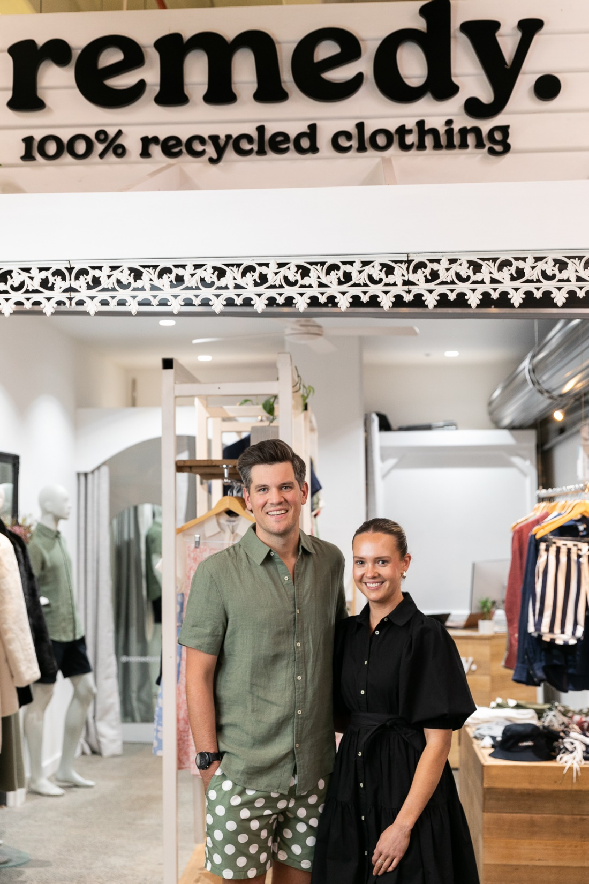
02
Environmental Sustainability Strategy 2023-27
Q3 actions & achievements

Slide 9
Environmental Sustainability Strategy actions & achievements
Q3 Strategy Actions Update
Initiative |  | Q1 - Q3 Actions | Status | Comments
Waste | Single use plastic reductions | Phase out of single use plastics |  | Second year bans on take away containers, polystyrene trays and balloons will commence 1 July 2024.
 |  | Early adopter grants 2023-24 |  | Three traders were progressed to Stage 2 and have submitted applications. Winners to be announced early May. 2022-23 project acquittals will be provided in June.
 | Waste reduction and improvement of waste processing | Improve partnership with food rescue organisation to increase collection volumes |  | The Market has entered a new partnership with the Port Phillip Community group, to commence on 14 May 2024
 |  | Develop a “reusables first “campaign to encourage customers to avoid single use items |  | Campaign has been briefed and will focus on videography showing customers and traders using reusable items.
 |  | Undertake review of current waste streaming to identify best practice processing and outcome opportunities. |  | Initial draft of Waste Study has been completed and feedback provided to consultants.
 | Stall Fit-Out and Asset Upgrade Environmental Impact Reduction | Develop procurement standards for market printed material and signage |  | Standard development in progress. Paper collateral is already 100% recycled paper.
Carbon Emissions | Reduce electricity use and increase energy efficiency across Market operations | Increase energy efficiency standards of systems and appliances (such as hot water systems) AS UPGRADED |  | Energy efficiency upgrades will be incorporated into the Asset Management Plan.
Water | Reduce potable water at use the Market | Include guidelines on suitable cleaning products in Environmental Sustainability Licence Guidelines. |  | Guidelines have been drafted and will be included in new Licences from 1 July 2023.
Completed
On track
Off track

Slide 10
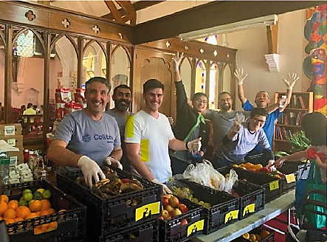
Environmental Sustainability Strategy Q3 actions & achievements
Food rescue
While the Market is very proud that its food waste is diverted from landfill, the better outcome is that food doesn’t get wasted at all.
To improve food rescue volumes, the Market has partnered with Port Phillip Community Group (PPCG) to help deliver the Share the Food program, providing food staples, toiletries and hygiene products to people facing financial hardship.
Every Sunday, starting from 12 May, PPCG will be collecting food from traders at closing time.
Instead of going to the organics bin, Traders’ produce will go towards:
A local network of 20 agencies
Social Meals program feeding 150 residents each month, in 13 community and rooming houses
Food parcels for individuals and families

Slide 11
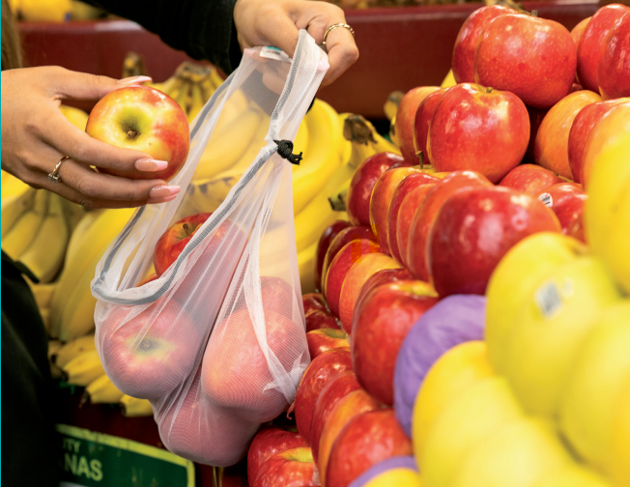
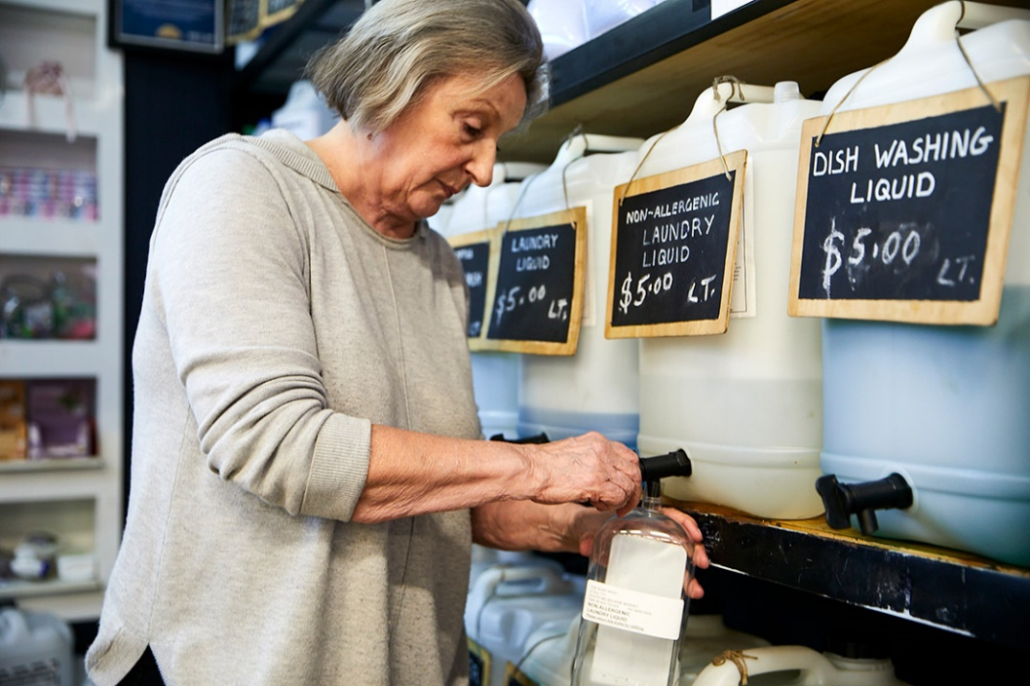
Environmental Sustainability Strategy Q3 actions & achievements
Embedding Sustainability
To ensure new traders are aligned with the Market’s Sustainability Strategy, they will be required to provide specific information detailing the waste products their business will create and the actions they will take to:
reduce the waste their business generates
use energy wisely
avoid wasting water
make some better choices in their supply chains.
The weighting of this criteria in the final decision will depend upon the type of business being sought and the Market’s retail strategy.
As part of their licence renewal, existing traders will also be required to provide a Sustainability Action Plan, identifying ways they can improve the sustainability of their businesses.

Slide 12
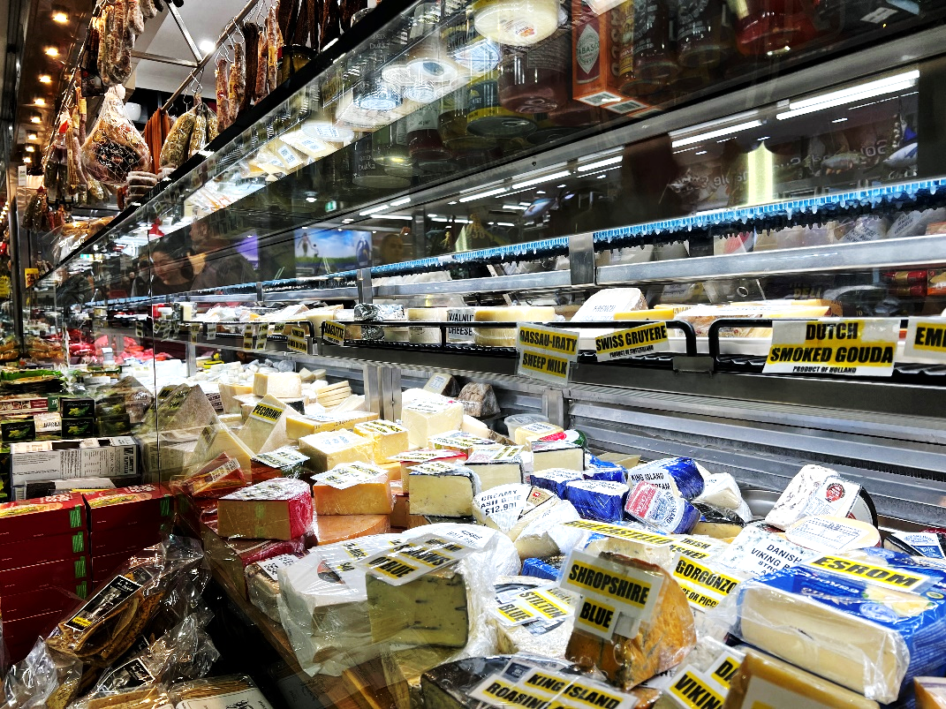
Environmental Sustainability Strategy Q3 actions & achievements
Early Adopter Grant Recipient Spotlight:
Theo’s Deli
Unlike a good parmigiano reggiano, refrigeration systems do not age well. After many years of use, Theo’s Deli’s fridges were old and inefficient, emitting unnecessary carbon emissions into our atmosphere.
Theo’s used their Early Adopter Sustainability Grant to upgrade their corroded refrigerator coils and drip trays with a new system that is expected to halve their energy use. Since the project’s completion in February 2024, Theo’s has seen a reduction in not only energy use but also food waste – the improved system reduces spoilage by keeping products at an ideal temperature and humidity level.

